Slide 1


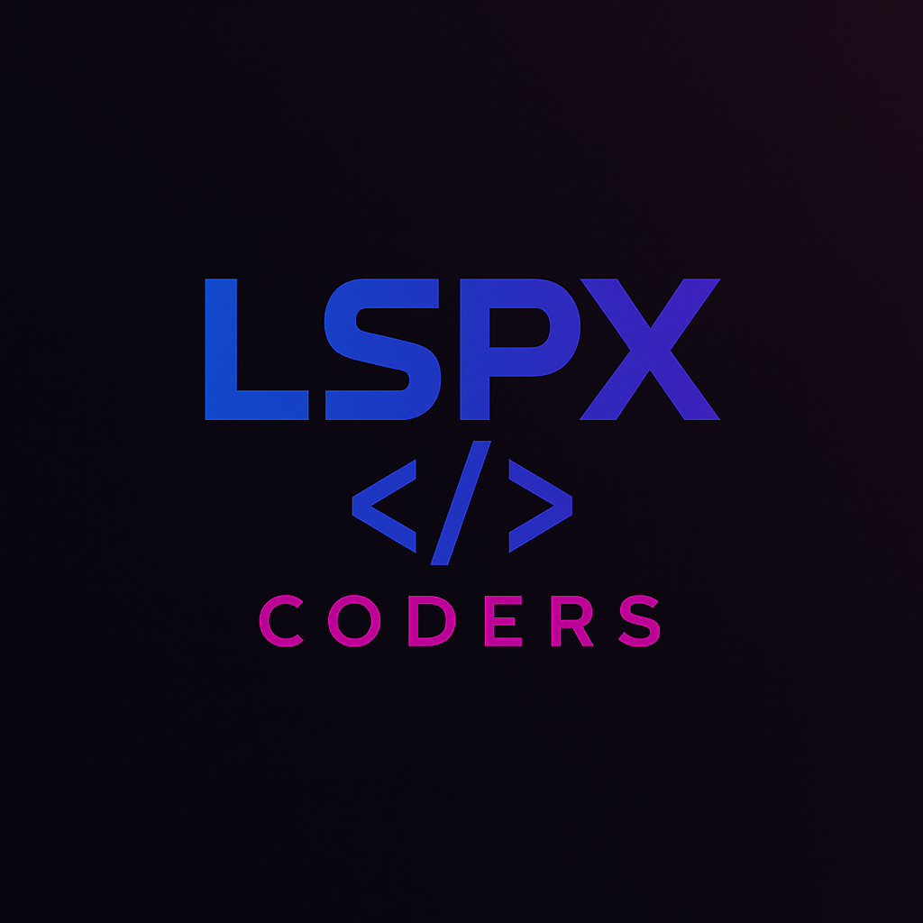



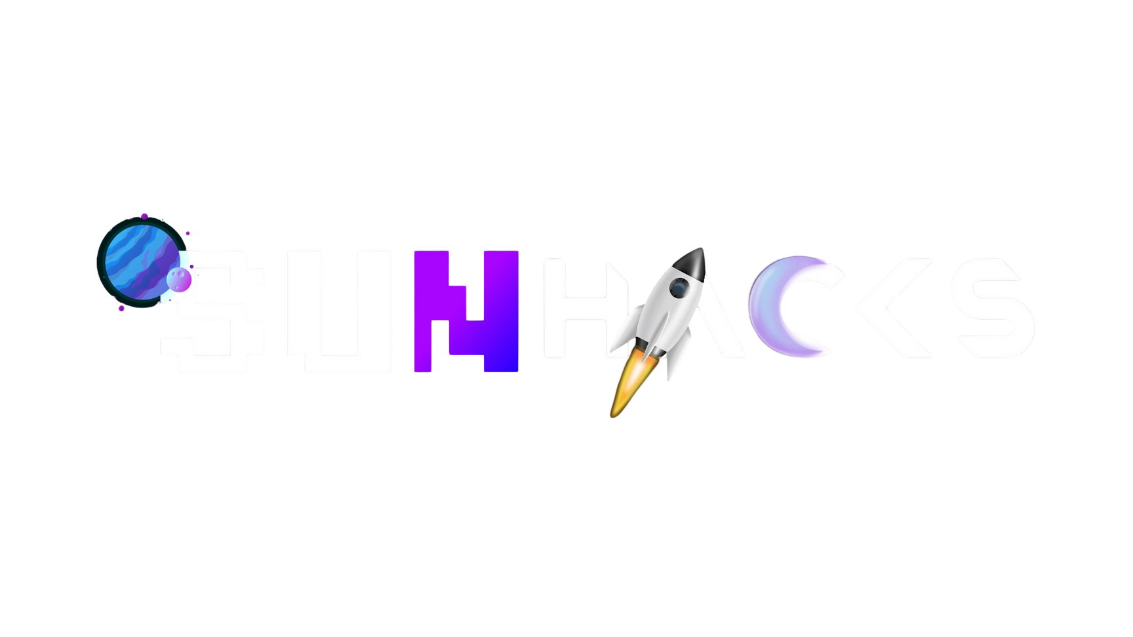
SCHOOL OF COMPUTER SCIENCE & ENGINEERING
DEPARTMENT OF COMPUTER SCIENCE & APPLICATION
PRSENTS
2025
INDIA’S LARGEST GENAI HACKATON
36 HOUR INTERNATIONAL LEVEL HACKATHON
TEAM NAME: LSPX Coders
PROJECT TITLE : HealthLock – Secure Patient Record Sharing
TRACK : Health Tech
UNIVERSITY NAME : Sandip University

Slide 2

PROBLEM STATEMENT
Patients struggle to digitally store, organize, and share health records (PDFs, images) securely.
Doctors, pharmacies, and diagnostic centers lack a simple, privacy-respecting way to access these records.
Existing sharing methods can expose all data, lack role-based access, and fail to provide audit trails.
Many solutions do not allow patients to control who sees what and for how long.
The challenge:
How can patients safely share health data using modern technology, maintaining complete privacy, control, and transparency?

Slide 3
PROBLEM SOLUTION
How HealthLock Solves It:
Secure Medical Records Vault: Patients upload digital health documents which are stored with robust encryption.
QR/Token-Based Sharing: App generates a time-limited QR or token to share only selected files with any health professional.
Role-Based Access (RBAC): Patients choose access level—Doctor (full), Pharmacist (meds only), Diagnostics (read-only)—before sharing.
Audit Trail & Instant Notifications: Every access attempt is logged with timestamp and user, notifying the patient to ensure transparency.
Simple, User-Friendly Interface: Quickly upload, share or revoke access to records from a single dashboard.

Slide 4
HOW YOU PLAN TO USE GENERATIVE AI
Cloud Storage & End-to-End Encryption: Store and encrypt health files for privacy and security.
QR Code & Token Engine: Generate expiring QR codes/tokens for secure, time-limited data-sharing.
Role-Based Access Logic: Backend enforces permissions, ensuring only authorized info is shared based on receiver’s role.
Real-Time Audit Logging: Log all accesses, show them visually to patients; push notifications for every access.
FHIR API Compliance: Use standards for healthcare interoperability and future integration with hospitals.

Slide 5
TECH STACK OR TOOLS YOU INTEND TO USE
Frontend: Android (Kotlin), Material Design, Jetpack Components
Backend: Firebase Auth, Firestore, Storage, Cloud Messaging
Security: JWT tokens, AES end-to-end encryption
QR Code: ZXing or Google ML Kit
Database & Auth: Firebase (reliable, scalable, real-time)
Deployment: Google Play Console
Design & Prototyping: Figma (UI/UX design)
API Integration: FHIR standards (for health data)

Slide 6
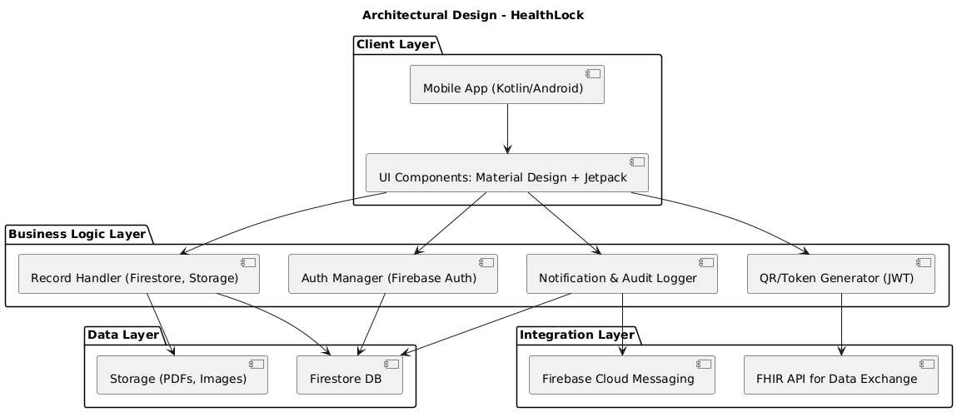

Slide 7
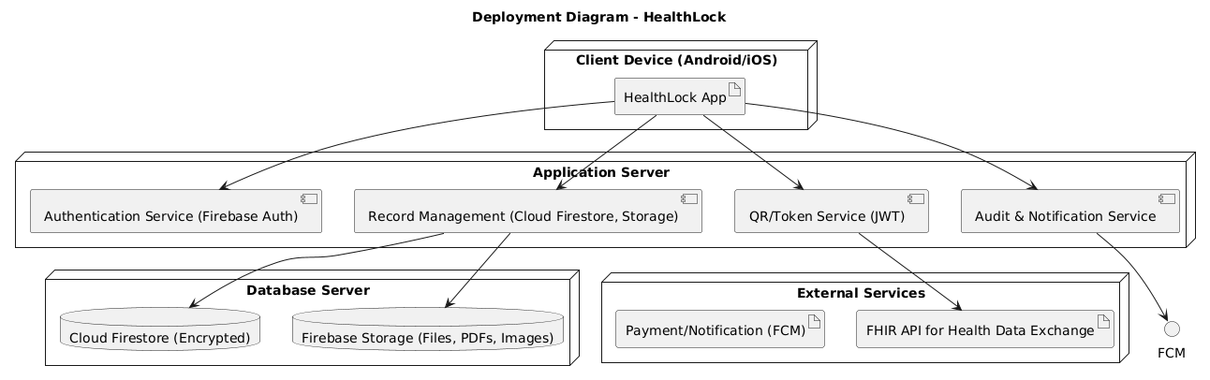

Slide 8
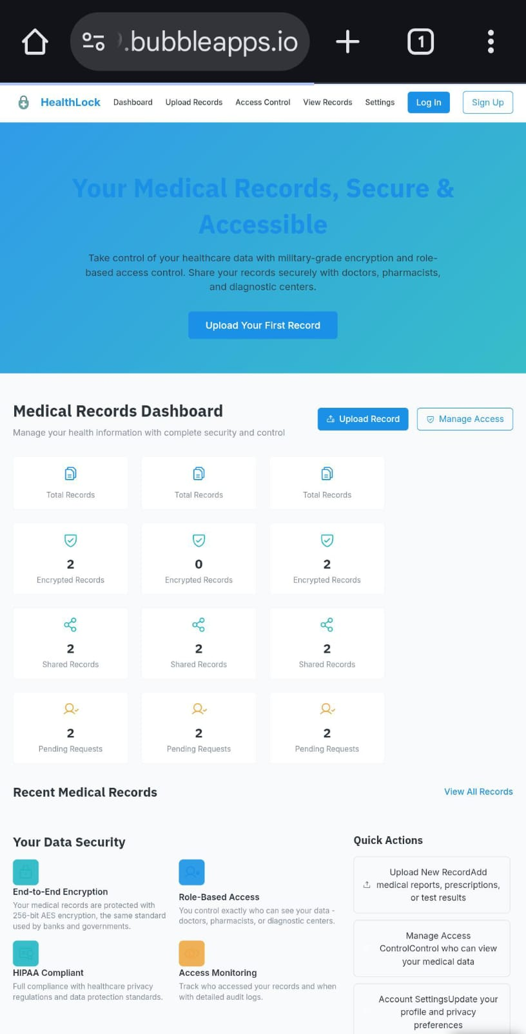
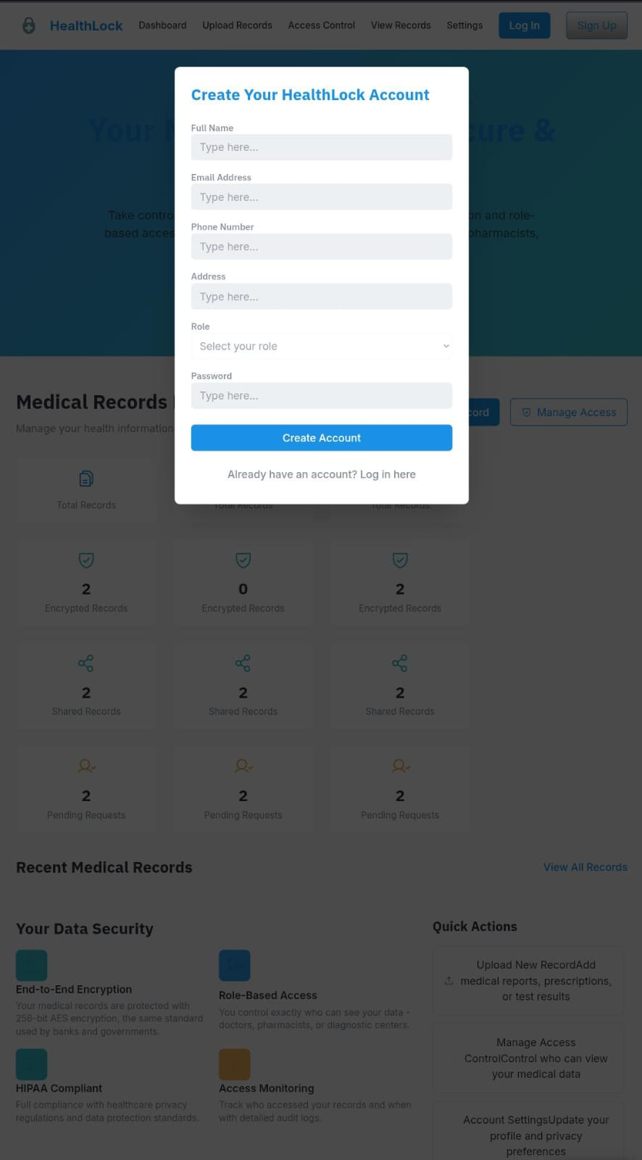
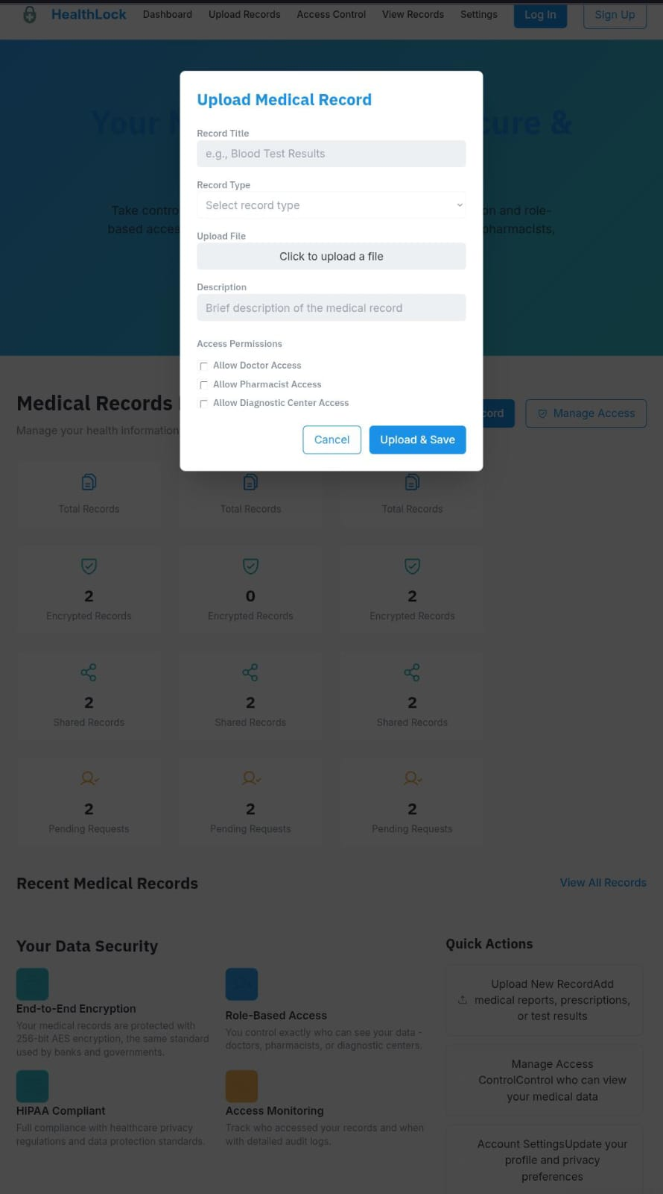
SnapShots

